Slide 1
This presentation template is designed for use by elected representatives.
Please note that it is not complete until you have added information about your local work and activities. All text highlighted in YELLOW is to be adapted for your own use.
Instructions for each slide can be found in the accompanying notes.
Notes:
<-- Instructions to the presenter-->
Purpose: To explain how to use this PowerPoint presentation.
Action: Adapt and add to this PowerPoint presentation so that it works best for you. Anything highlighted in yellow should be adapted to your needs and situation – remember to remove the yellow highlighting! This slide should not be shown to the participants.
<-- Script -->
This slide has no script.

Slide 2

Akademikerföreningen –
The Association for Graduate Professionals
Represents all members of Saco unions employed at
Company X
Contact details of the workplace association board.
Notes:
<-- Instructions to the presenter-->
Purpose: To explain who you are and who you represent.
Action: Fill in the board members’ contact details. It’s a good idea to add pictures of the board members.
<-- Script -->
Introduce yourself and explain……………?????

Slide 3
The work of the Association at Company X
Current local issues:
Issue 1
Issue 2
Issue 3
Notes:
<-- Instructions to the presenter-->
Purpose: To explain briefly the work done locally by the board at the workplace. Talk about both current issues and issues that always require attention. The aim is to show the value to the members of the trade union work that you do.
Action: List 1-3 important/ongoing local issues. If you have more than 3, try to limit yourself to three that you list on the slide and mention the others without having them in writing. You should of course focus on the matters that your members think are importtant and how the issues affect them.
<-- Script -->
If you would like to receive coaching about how to formulate your script, you are welcome to contact us at anna.klaesson@sverigesingenjorer.se or daniel.jarblad@sverigesingenjorer.se.
Try to use phrases that show the value of your work, such as:
"For you, this means that…”
”In your/our case, this means…”
”This has given us more/better/greater…”
Example: ”We are currently in a co-determination negotiation with the company where we are pushing for more XXX, which will mean XXX for you and your colleagues.”

Slide 4

Who can be a member of a Saco union?
(& Akademikerföreningen)
Notes:
<-- Instructions to the presenter-->
Purpose: To emphasise that if you have a higher education qualification, you can (should) be a member of a Saco union. It’s better that more people apply than are eligible than that people who are eligible do not think they are welcome.
Action:
<-- Script -->
Anyone with at least three years of higher education studies can be a member of a Saco union, and thus Akademikerföreningen/the Association for Graduate Professionals. Here are just some examples of people who are eligible to join a Saco union and the association.

Slide 5

Find the right union for you
Notes:
<-- Instructions to the presenter-->
Purpose: To explain to those interested in joining how they can find the right union.
Action:
<-- Script -->
You become a member of the Akademikerförening/Association at your workplace by joining a Saco union. If you are unsure of which union is the right one for you, visit saco.se/karriar/hitta-ditt-sacoforbund/ or talk to us and we will be happy to help.

Slide 6
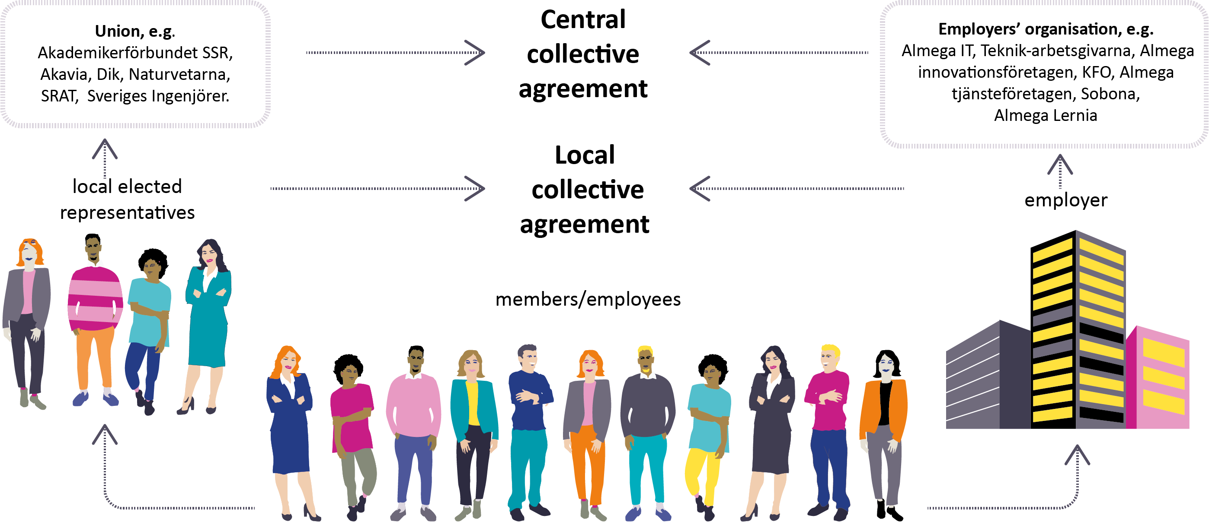
The Swedish model – central och local
Notes:
<-- Instructions to the presenter-->
Purpose: To explain how the Swedish model works
Action: Use this picture if you think there is a need to explain the Swedish model.
<-- Script -->
Depending on the audience’s existing knowledge and understanding of the Swedish model and its advantages, e.g. with regard to independent trade unions, small number of conflicts, flexibility and more.

Slide 7


How we are organised
Company X
Akademikerföreningen
Other workplace
union associations
Saco unions at our workplace:
Union 1
Union 2
Union 3
Union 4
Union 5
Union 6
Union 7
Notes:
<-- Instructions to the presenter-->
Purpose: To explain the relationship between the akademikerförening/association and the members of the various Saco unions, as well as the relationship with the employer and other local union associations at the company.
Action: Fill in the names according to the unions at the workplace in question. Include any other local union associations at the same employer.
<-- Script -->
There may be other local trade union associations at the company. This picture shows how the members of the different Saco unions come together to form the Akademikerförening/Association for Graduate Professionals at the company.

Slide 8
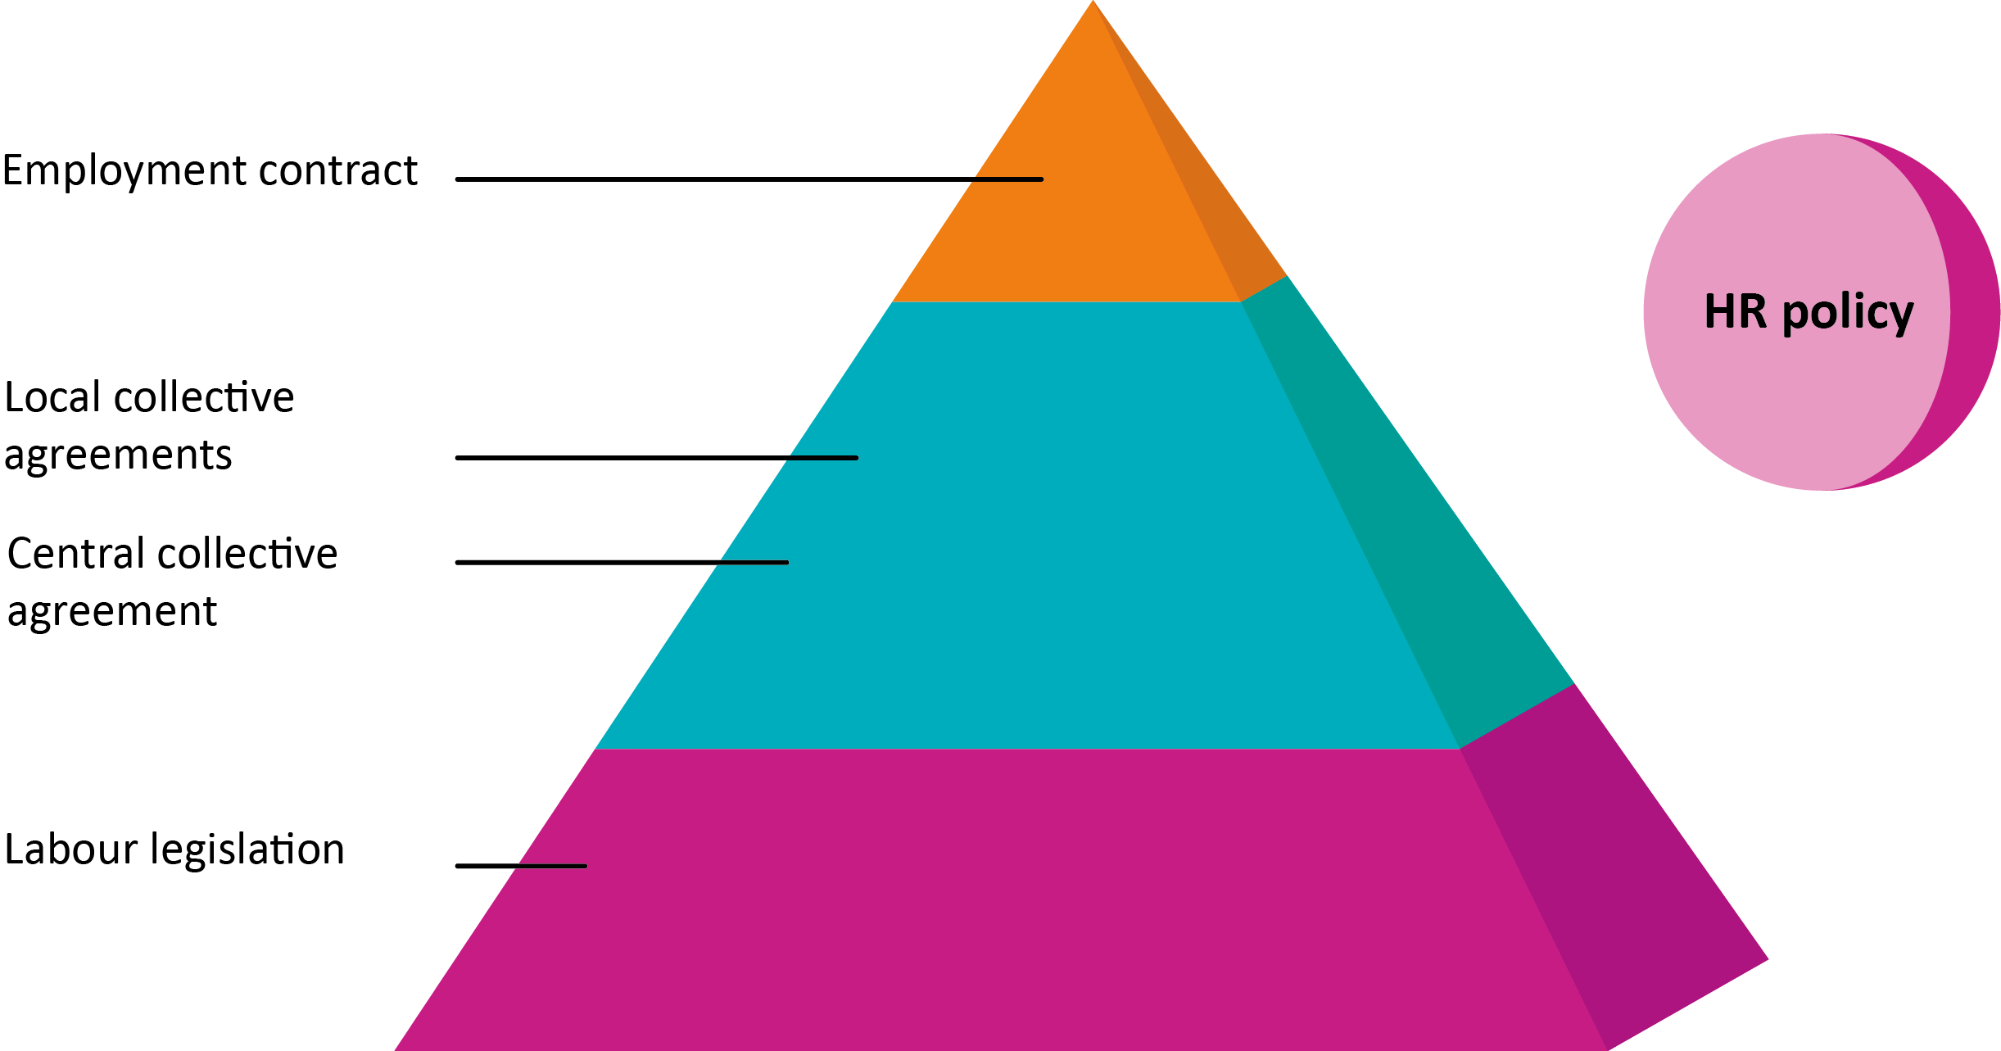
Law – collective agreement - contract
Notes:
<-- Instructions to the presenter-->
Purpose: This slide is for use if you wish and if you believe it is necessary. It explains the relationshipbetween legislation, collective agreements and employment contracts. It also shows the importance of collective agreements, where the union ishas the possíbility to change provisions regulated by law.
Action:
<-- Script -->
When it comes to your rights and benefits at work, certain matters are regulated by laws. The laws apply to all people employed in Sweden. However, it is quite a small number of things that are regulated by labour law, and these can often be regarded as minimum levels. Instead, many and better benefits are regulated by collective agreements. There are collective agreements that cover entire sectors, and there may be complementary collective agreements that only apply at a specific company.
* Say something about the collective agreement at your workplace.
Additionally, you can make agreements with your manager about certain benefits beyond thióse of the collective agreement, and these are regulated by your employment contract. The basic rule is that you can always agree better conditions than those stipulated by law or the collective agreement, but never worse conditions. For example, the law says that everyone has the right to 25 days of paid annual leave, but the collective agreement may include rules providing more days, and you can reach agreement with your manager about even more days in your employment contract.
The company may also have a set of policies covering different matters and benefits.

Slide 9
Education must be rewarded
We work to ensure that you receive your share of the value you create
We work to safeguard your rights and interests
We monitor that the company treats its most important resource – its staff – in a sustainable way.
Notes:
<-- Instructions to the presenter-->
Purpose: To highlight the reasons why we think it’s important that education is rewarded; that your investment in education makes you a valuable asset to your employer.
Action:
<-- Script -->
Three fundamental issues that Saco, the Saco unions and the local Association focus on at different levels.
Explain in more detail and describe how they relate to the work that you do locally.

Slide 10

We work at three levels
Notes:
<-- Instructions to the presenter-->
Purpose: To give a brief and general explanation of how we work at central and local level with the issue of ”education must be rewarded”:
Nationally – through opinion-building and influence
At the workplace – through negotiations, collective agreements etc
Individually – through individual membership of a Saco union
Action:
<-- Script -->
Nationally: Opinion-building and political influence. As a member of a Saco union, you add to the strength of our work with influence and opinion building on the issue of rewards for higher education in the form of good employment conditions, higher salaries and employers valuing the employment of highly educated people as a genuine investment.
Towards employers: Negotiations and collective agreements
Individually: The service and membership benefits you receive as a member of a Saco union and the Akademikerförening/Association. Representation.

Slide 11
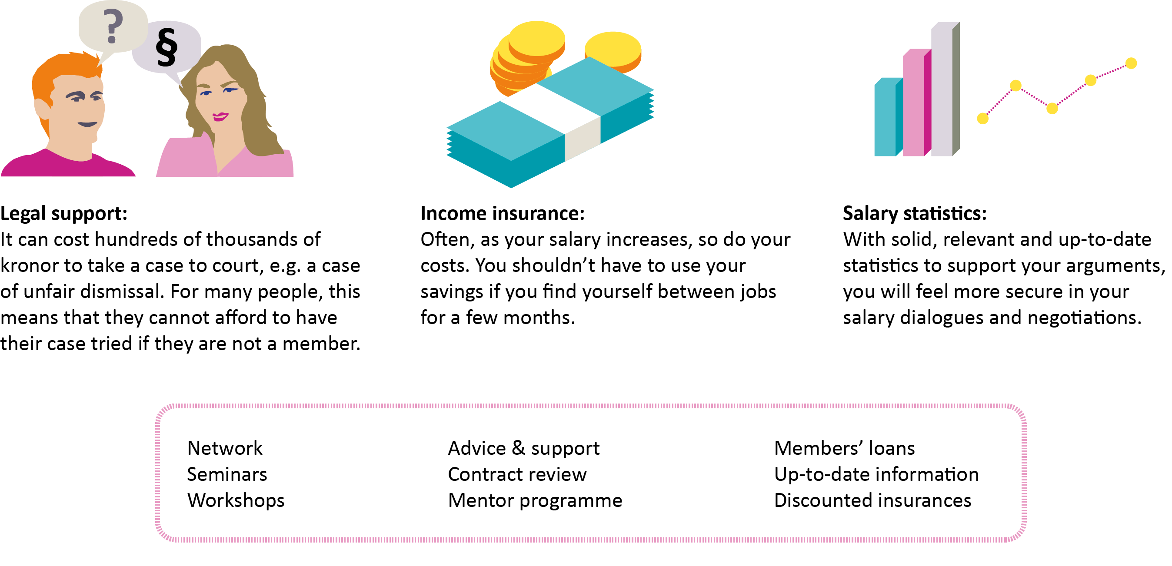
Your membership
Notes:
<-- Instructions to the presenter-->
Purpose: To give examples of the membership benefits available and which all Saco unions offer their members.
Action:
<-- Script -->
Here are some examples of the benefits directly linked to your membership of a Saco union, no matter where you work. Visit your Saco union’s website to find out more about these and other membership benefits.
Legal support:
It can cost hundreds of thousands of kronor to take a case to court, for example in case of unfair dismissal. For many people, this means that they cannot afford to have their case tried if they are not a member.
Income insurance:
Often, as your salary increases, so do your costs. You shouldn’t have to use your savings if you find yourself between jobs for a few months.
Salary statistics:
With solid, relevant and up-to-date statistics to support your arguments, you will feel more secure in your salary dialogues and negotiations.

Slide 12

Welcome to Akademikerföreningen at
Company X
Join today
Start by visiting saco.se/karriar/hitta-ditt-sacoforbund
Or ask us for more information
Notes:
<-- Instructions to the presenter-->
Purpose: To welcome the new employees/audience and encourage them to act now to become members.
Action:
<-- Script -->
Don’t put off applying for membership. You need to have been a member for a few months before you can take advantage of some of the benefits of membership, e.g. legal support and income insurance. If you only join when you need help, it will be too late. So my advice to you is to join today.

Slide 13
See you again soon!
www.saco.se/foretaget
brevlada.af@foretaget.com
Tel: XXX-XXXXXXX
akademikerforeningen.foretaget
Office: Building X, room XX
Notes:
<-- Instructions to the presenter-->
Purpose: To provide the Association’s contact details so that people know where to turn if there is anything they would like to ask or discuss.
Action: Fill in the relevant details. It’s also a good idea to add pictures of the local board.
<-- Script -->
Explain how they can reach you, show pictures of board members who are not at the meeting and explain where you can be found and when/how people can meet you.

